Slide 1

JRF Membership Focus Study
Program for improving the services provided by JRF congregations to their membership

Slide 2
Proposal
Implementing a value-driven measurement system for the Jewish Reconstructionist Federation that results in expanding membership, improving relevancy, and increasing revenue potential for its members and JRF.

Slide 3
Deliverables
Providing a unified vision for delivering sustainable value for members, congregations, and the entire reconstructionist movement.
Driving innovation to deliver service & products in new and creative ways.
Driving collaboration & community involvement.
Developing a member-first orientation for JRF and its member organizations.

Slide 4
Challenges
Escalating Costs
Dwindling Membership
Silos of Funding Models
How do we measure
value ?

Slide 5
The Approach
Provide a way to measure value from the perspective of the customer:
The Members
The Organizations
The Local Community

Slide 6
Enhancing the Membership Model
Members
Clergy, Staff, & Leadership
Congregations & Partners
Providing Members with a way to measure the value they should be receiving from their congregation.
Guiding Congregational Leaders to measure and optimize the value they deliver to Members.
Guiding JRF to deliver optimized value for their organizations and overall membership.
JRF

Slide 7
Enabling Value for Jewish Reconstructionism
Value-Driven Platform
Technology
Ideas
Resources
Innovation
Value Measurement
New Concepts
New Products & Services
New Value Delivery
Outcomes
Compliance
Quality & Efficiency
Value-Driven metrics are used to drive innovation & direct Quality & Efficiency

Slide 8
Project Overview

Slide 9
Project Charter
Project Charter | Developing New Products & Services to drive membership.
Project Number | JRF - 001 | Charter Date | February 1st, 2010
Project Sponsor | JRF Board of Directors | Project Director | Jeff Wallk
Project Scope | Design and implement a customer focus framework for capturing and modeling metrics used to model the outcomes for customers and a set of metrics for which to benchmark the products & services delivered by JRF and its member organizations.
Objectives | Implement a customer focus methodology Create a reference model for identifying customer outcomes and metrics for measuring value Define a complete list of jobs performed by members Create a repository of customer outcomes & value metrics Develop a process to prioritize and align the outcomes & metrics with GAPS in products & services
Timeline | Project Breakdown 3 weeks of planning 4-6 weeks of execution Qualitative study Quantitative study 1 week of presentation

Slide 10
Methodology (Planning)
Definition
Model a Job (reference model)
Model the Domain
Model the Job Ontology w/in the Domain
Location
Identify the sub-domain to study
Select the Job(s) w/in the sub-domain to study
Preparation
Interview SMEs who have or do currently execute the job
Draft the Job Reference Model for this instance (particular job)
Confirmation
Review the Domain Model
Review the Job Ontology Model
Review the Job Reference Model for this instance with SMEs
Obtain feedback and iterate the above artifacts

Slide 11
Methodology (Execution)
Execution (includes iterations of Monitoring & Modification)
Qualitative Study (Phase 1)
Interview designated job executors
Capture notes from meetings
Capture notes from observations
Transform notes into desired outcomes
Data Profiling, Cleansing, and Quality
Verify Cleansed Listing of Desired Outcomes

Slide 12
Methodology (Execution)
Execution (includes iterations of Monitoring & Modification)
Quantitative Study (Phase 2)
Prepare a survey
Prepare profiling questions
Provide script for survey executor to read
Prepare separate surveys using the desired outcomes
Targeted to specific job executors
Tailored for limited scope to reduce impacts from fatigue
Capture 2 key metrics for each desired outcome (importance & satisfaction)
Identify sample list of survey candidates (job executors)
Conduct Survey
Ideally, should be 3rd party but must be done with anonymity
Must capture profiling information
Must be able to conduct survey over phone, electronically or via written response
Data Cleansing
Data Analysis (per Core Functional Job)

Slide 13
Methodology (Presentation)
Conclusion
Thematic extraction from above analysis
Focus only on the patterns impacting desired outcomes w/ highest opportunity
Presentation of findings to the steering committee

Slide 14
Program Governance
JRF
Board
Program
Steering Committee
Program
Director
Team

Slide 15
Staffing Plan
Steering Committee
Jeff Wallk
JRF (Marketing) Dan Cedarbaum
JRC (Evanston) President
JRC (Evanston) Rabbi
SH (Northbrook) President
SH (Northbrook) Rabbi
EHNTJC (Skokie) President
EHNTJC (Skokie) Rabbi
Board of Directors
TBD
Project Team
Jeff Wallk
Volunteer 1
Volunteer 2
Note: Leaders from the congregations can also appoint a designee on their behalf.

Slide 16
Key Milestones & Deliverables
Qualitative Phase:
Job Study for Project Scope
Prioritize the jobs to study
Develop an interview plan
Conduct interviews (capture outcomes)
Analyze outcomes & complete analysis
Quantitative Phase:
Draft survey (using outcomes)
Conduct survey (measure outcomes)
Analyze results & identify opportunities
Presentation of findings
To Steering Committee
To JRF Board

Slide 17
Future Deliverables
Establishing an opportunity pipeline
Transition ideas to innovation
Institutionalize the customer focus program
Develop a growth strategy for JRF & its congregations
Develop a roadmap of products & services to address the opportunities

Slide 18
A few definitions

Slide 19
What is a Job ?
The methodology is based on a perspective of measuring the desired outcomes that an individual would like to achieve within the context of a particular "job" that he/she is trying to get done.
A job is quite simply a definition of what people are actually trying to "get done“.

Slide 20
What are Outcomes ?
Each job is comprised of a common set of activities (steps if you will) which involve planning, preparing, executing, monitoring, adjusting, and completing the work to be done.
A person trying to complete these steps has a set of desired outcomes they wish to achieve for each step in the job. We call these outcomes and they can be measured.

Slide 21
What is a Job Model ?
A job model is an attempt to identify the relationships between the core job that a person is performing and all the other jobs that can influence the outcomes for the job:
Direct & indirect functional jobs
Supply chain jobs
Emotional & Spiritual Jobs
All of these can be captured initially & measured eventually (depending on the scope of the study)

Slide 22
The Job Model
Job
Reference Model
Other Functional
Jobs
Core Functional
Job
Functional
Jobs
Supply Chain Jobs
Spiritual
Jobs
Job Steps
&
Outcomes
Emotional
Jobs
This is where customer value is measured

Slide 23
Thank You
Prepared by
Jeffrey Wallk

Slide 24
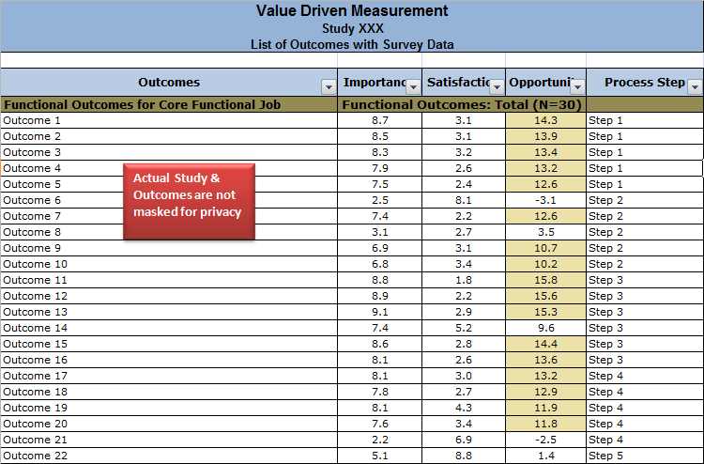
Quantitative Data from Study
Actual outcomes and metrics are masked for privacy

Slide 25
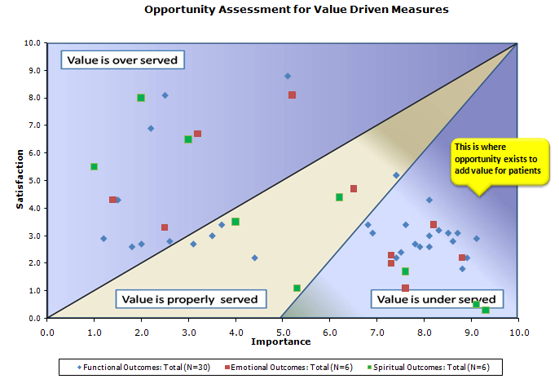
Quantitative Analysis from Study
This is where opportunity exists to add value for members

Slide 26
If you are interested in obtaining more information about our services, please visit us online or contact us directly.
Online: www.enablingvalue.com
Phone: (847) 261-IDEA
Email: jeffrey.wallk@enablingvalue.com

